Slide 1
Natural Language Processing with Disaster Tweets
MGMT 590 – Machine Learning
Tushar Malankar
Himanshu Sharma

Slide 2

An Introduction to the Project
With the rise of social media, platforms like Twitter serve as real-time sources of information during disasters. However, distinguishing between genuine disaster-related tweets and irrelevant noise is a challenge.
Multiple agencies are showing interest in ways to “programatically monitor Twitter” to leverage the platform’s unique ability to capture users’ real-time experience with minimal latency.
This project aims to develop a Natural Language Processing (NLP) model using BERT to accurately classify tweets as disaster-related or not, enabling better crisis response and information filtering.

Slide 3
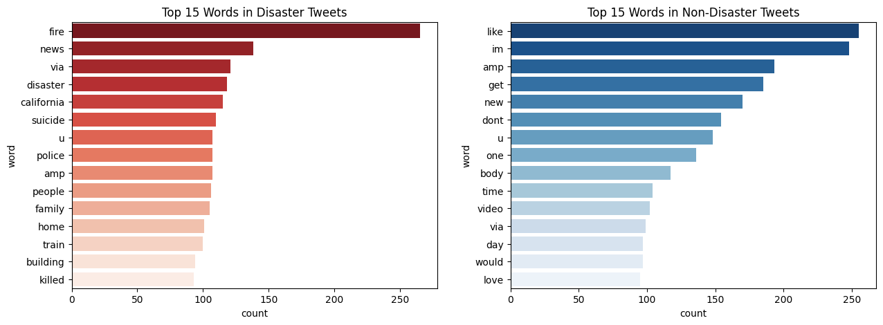
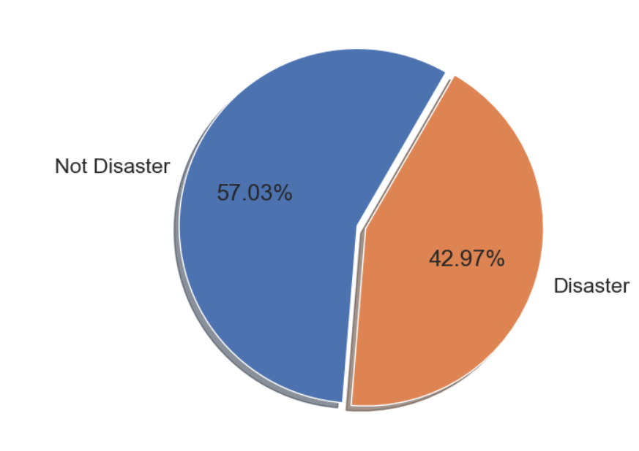
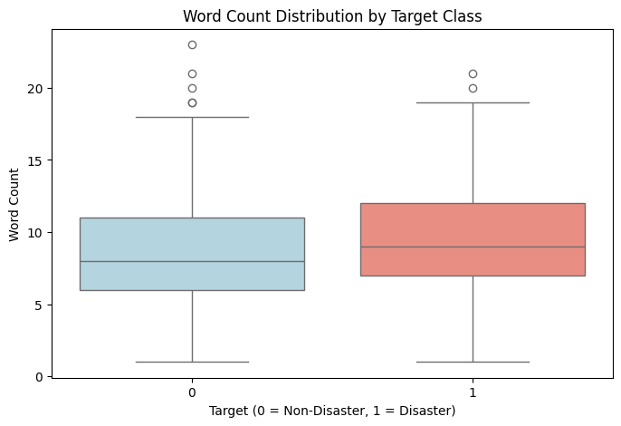
Exploratory Data Analysis – A starting point
EDA 1: Target Variable Balance
EDA 2: Word counts in tweets
EDA 3: Target Variable Balance
Finding: Since there is no significant class imbalance we didn’t need any kind of sampling technique
Finding: We noted that there is a minor difference in word counts per tweet, with disaster tweets having a slightly higher word count
Finding: The top words appearing on disaster tweets are largely separate from non-disaster tweet, which is good for our modelling
The EDA provided us with a robust foundation to begin our modelling exercise

Slide 4
Pre-Processing – Setting up for successful modelling
Pre-Processing Step | Description
Noise Removal & Standardization | Removed unwanted elements like URLs, emojis, HTML tags, and punctuation using regular expressions (re module) to clean the text.
Tokenization & Stopword Removal | Tokenized text using NLTK’s word_tokenize and eliminated common stopwords from NLTK’s stopwords corpus to focus on important words.
Lemmatization & Normalization | Converted text to lowercase for consistency and applied WordNet Lemmatizer (NLTK’s WordNetLemmatizer) to reduce words to their root forms
Focusing on the pre-processing allowed us to keep the textual data in as suited a format as possible for model building

Slide 5



We looked at three different embedding approaches
GloVE LSTM
Graph Convolutional Network
BERT Classification
Using Transformers
Why this approach?
This is a natural starting point for most NLP problems
Pre-trained for this type of problem
Easier computationally, compared to other embedding approaches
Why this approach?
Idea – tweets can be looked at as graphs, since some of them have semantic similarity with the other
We could take advantage of this and try out a GCN approach to model the NLP problem
Why this approach?
BERT is a bi-directional, non-static embedding
This allows is to excel in understanding the context of a tweet
This makes BERT a logical next step from the previous approaches
Results:
Kaggle F1-Score: 0.795
Results:
Kaggle F1-Score: 0.797
Results:
Kaggle F1-Score: 0.844
Conclusion:
Room for improvement. Should explore other approaches
Conclusion:
This method needed advanced knowledge to tune and refine, often facing overfitting
Conclusion:
The best model yet! This model gave us our highest accuracy.
After running our model with BERT, we achieved an F1-Score 0.844, ranking 22nd on the overall leaderboard

Slide 6


BERT – a deep dive into our best model
BERT – Key Properties
Our BERT Model
Layer | Description
Embeddings | Word, Position, and Token Type embeddings with LayerNorm and Dropout.
Encoder (×24) | 24 Transformer layers, each with Self-Attention, Feedforward, and LayerNorm.
Pooler | Dense layer with Tanh activation for [CLS] token representation.
Dropout | Regularization layer to prevent overfitting.
Classifier | Final Linear layer (1024 → 2) for classification.
Bidirectional Encoder Representations from Transformers
Pre-trained knowledge for NLP problems
Non-Static,
Bi-directional embedding allows for context-based learning
Good at inferring meaning of unseen words through sub-words tokenization
Note: We used a “bert-large-uncased” model
BERT presents an innovative and well-tailored approach to solving this particular NLP problem
Notes:
Model 2 was over fitting, to prevent it to overfit on test data we decided to add the previous model.

Slide 7
Model performance assessment
Epoch | Training Loss | Validation Loss | Accuracy | F1 Score | Training Time | Validation Time
1 | 0.49 | 0.41 | 0.83 | 0.78 | 0:13:07 | 0:00:14
2 | 0.36 | 0.44 | 0.82 | 0.78 | 0:16:56 | 0:00:50
3 | 0.31 | 0.41 | 0.84 | 0.79 | 0:18:30 | 0:00:50
Final Kaggle F1-score: 0.844
Kaggle Leaderboard Rank: 22nd
The model was computationally heavy; however, it seemed to achieve a very high accuracy in only 3 epochs.
Notes:
Model 2 was over fitting, to prevent it to overfit on test data we decided to add the previous model.

Slide 8
Challenges we faced in the project
Challenge | Insight
Overfitting | The model memorizes training data but fails on new data. Use dropout, regularization, or early stopping
Computationally Intensive | Overall, the model took about 50 minutes to train and validate
Shape Mismatching Errors | Tensor dimensions don’t align between input and output layer, causing layer incompatibility. Debug using model summaries and reshape inputs correctly.
Deprecating Libraries | Since libraries are constantly evolving, functions and libraries used by us always have a risk of being obsolete/modified in the future

Slide 9
References
Danday, A., & Murthy, T. S. (2022). Twitter data analysis using Distill BERT and Graph-Based Convolution Neural Network during disaster. Liverpool John Moores University & Chaitanya Bharathi Institute of Technology. https://doi.org/10.21203/rs.3.rs-2041154/v1
Ma, G. (Year). Tweets Classification with BERT in the Field of Disaster Management. Department of Civil Engineering, Stanford University, Stanford, CA 94305
Devlin, J., Chang, M.-W., Lee, K., & Toutanova, K. (2018). BERT: Pre-training of Deep Bidirectional Transformers for Language Understanding. CoRR, abs/1810.04805. Retrieved from http://arxiv.org/abs/1810.04805.

Slide 10
Thank You

